Slide 1
CS-2001 Data Structures
Week-01
Lecture-02

Slide 2
Agenda
Review of Object Oriented Programming
Four pillars
Abstraction,
Encapsulation,
Inheritance
Polymorphism
Functions and parameter passing
Pointers and their uses
Function pointers and (assignments and call)

Slide 3
OOP vs Procedural Language:
Object oriented programming is a way of solving complex problems by breaking them into smaller problems using objects.
Before Object Oriented Programming programs were written in procedural language, they were nothing but a long list of instructions. On the other hand, the OOP is all about creating objects that can interact with each other, this makes it easier to develop programs in OOP

Slide 4
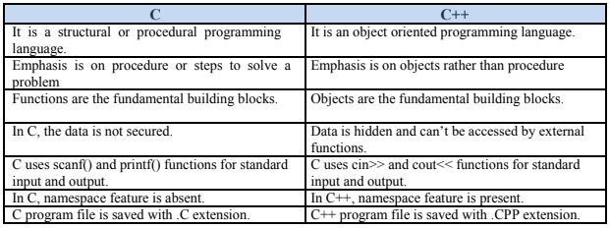
OOP vs Procedural Language:

Slide 5
Abstraction
Abstraction means displaying only essential information and hiding the details.
Data abstraction refers to providing only essential information about the data to the outside world, hiding the background details or implementation.
Abstraction using Classes:
Class helps us to group data members and member functions using available access specifiers.
A Class can decide which data member will be visible to outside world and which is not.
Members declared as public in a class, can be accessed from anywhere in the program.
Members declared as private in a class, can be accessed only from within the class. They are not allowed to be accessed from any part of code outside the class.
Abstraction in Header files:
For example, consider the pow() method present in math.h header file. Whenever we need to calculate power of a number, we simply call the function pow() present in the math.h header file and pass the numbers as arguments without knowing the underlying algorithm according to which the function is actually calculating power of numbers.

Slide 6
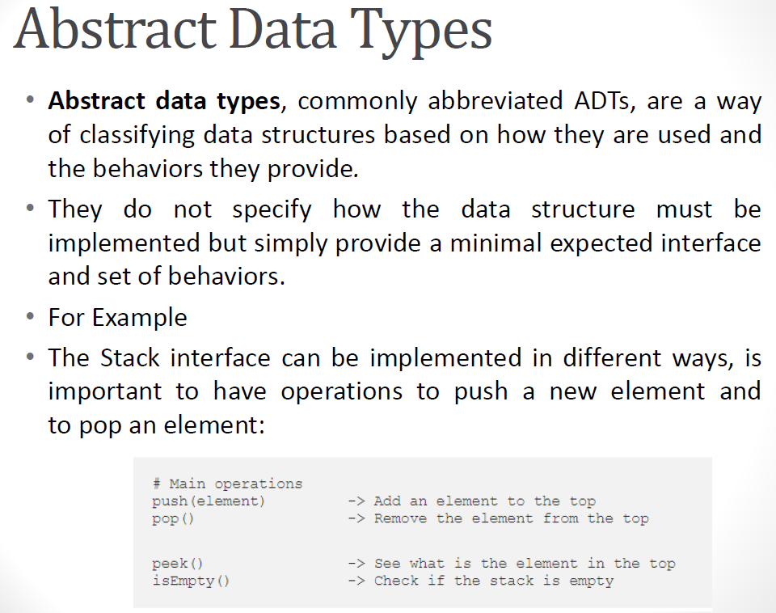

Slide 7
Encapsulation
When all the data members and member functions are combined in a single unit called class, this process is called Encapsulation.
In other words, wrapping the data together and the functions that manipulate them.
Preventing unauthorized access to some piece of information or functionality.
safety (information hiding) and usability (multiple instances)
Notes:
Data encapsulation refers to the process of binding together data and functions or methods operating on this data into a single unit so that it is protected from outside interference and misuse.
In a company, two software projects are going on with two different teams. One team requires data from the other team. But this team cannot access the data from the other team because they do not have the appropriate permissions. This is Encapsulation.

Slide 8
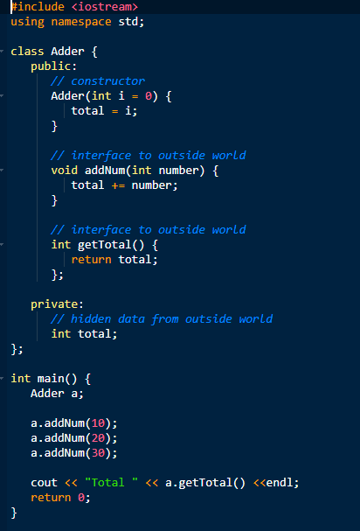

Slide 9
Encapsulation
Above class adds numbers together, and returns the sum. The public members addNum and getTotal are the interfaces to the outside world and a user needs to know them to use the class. The private member total is something that is hidden from the outside world, but is needed for the class to operate properly.
Encapsulation also leads to data hiding or abstraction.

Slide 10
Inheritance
Inheritance in C++ is one of the key features of Object-oriented programming. It allows user to create a new class (derived class) from an existing class(base class). This makes it easier to create and maintain an application. This also provides an opportunity to reuse the code functionality and fast implementation time. An existing class that is “parent” of a new class is called a base class. New class that inherits properties of the base class is called a derived class.

Slide 11
Types of Inheritance
Single inheritance
In this type of inheritance one derived class inherits from only one base class. It is the most simplest form of Inheritance.
Multiple Inheritance
In this type of inheritance a single derived class may inherit from two or more than two base classes.
Multilevel Inheritance
In this type of inheritance the derived class inherits from a class, which in turn inherits from some other class. The Super class for one, is sub class for the other.

Slide 12
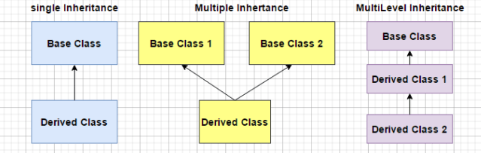

Slide 13
#include <iostream>
using namespace std;
// base class
class Vehicle {
public:
Vehicle()
{
cout << "This is a Vehicle" << endl;
}
};
// sub class derived from a single base classes
class Car: public Vehicle{
};
// main function
int main()
{
// creating object of sub class will
// invoke the constructor of base classes
Car obj;
return 0;
}
Output: This is a Vehicle

Slide 14
OutputThis is a Vehicle This is a 4 wheeler Vehicle
// first base class class Vehicle { public: Vehicle() { cout << "This is a Vehicle" << endl; } }; // second base class class FourWheeler { public: FourWheeler() { cout << "This is a 4 wheeler Vehicle" << endl; } }; // sub class derived from two base classes class Car: public Vehicle, public FourWheeler { }; // main function int main() { // creating object of sub class will // invoke the constructor of base classes Car obj; return 0; }

Slide 15
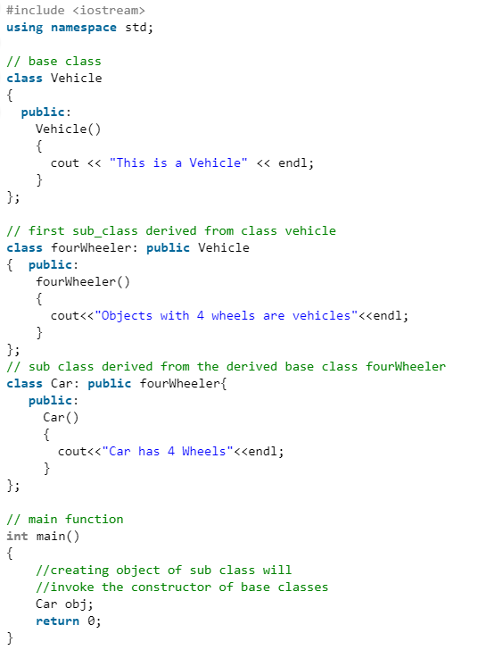
OutputThis is a Vehicle Objects with 4 wheels are vehicles Car has 4 Wheels

Slide 16
6. A special case of hybrid inheritance : Multipath inheritance:
A derived class with two base classes and these two base classes have one common base class is called multipath inheritance. An ambiguity can arise in this type of inheritance.
class ClassA {
public: int a; };
class ClassB : public ClassA {
public: int b; };
class ClassC : public ClassA {
public: int c; };
class ClassD : public ClassB, public ClassC {
public:
int d;
};
void main(){
ClassD obj;
obj.ClassB::a = 10; // Statement 3
obj.ClassC::a = 100; // Statement 4
obj.b = 20;
obj.c = 30;
obj.d = 40;
cout << "\n A from ClassB : " << obj.ClassB::a;
cout << "\n A from ClassC : " << obj.ClassC::a;
cout << "\n B : " << obj.b;
cout << "\n C : " << obj.c;
cout << "\n D : " << obj.d;
}

Slide 17
Output:
A from ClassB : 10
A from ClassC : 100
B : 20
C : 30
D : 40
Avoiding ambiguity using scope resolution operator: Using scope resolution operator we can manually specify the path from which data member a will be accessed, as shown in statement 3 and 4, in the above example.
obj.ClassB::a = 10;
obj.ClassC::a = 100;
Note : Still, there are two copies of ClassA in ClassD.
Avoiding ambiguity using virtual base class:
On next Slide

Slide 18
class ClassA
{
public:
int a;
};
class ClassB : virtual public ClassA
{
public:
int b; };
class ClassC : virtual public ClassA
{
public:
int c;};
class ClassD : public ClassB, public ClassC
{
public:
int d;
};
void main()
{
ClassD obj;
obj.a = 10; //Statement 3
obj.a = 100; //Statement 4
obj.b = 20;
obj.c = 30;
obj.d = 40;
cout<< "\n A : "<< obj.a;
cout<< "\n B : "<< obj.b;
cout<< "\n C : "<< obj.c;
cout<< "\n D : "<< obj.d;
}
Output:
A : 100 B : 20 C : 30 D : 40

Slide 19
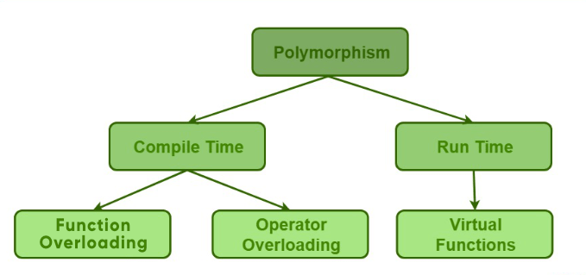
Polymorphism
Polymorphism in C++ means, the same entity (function or object) behaves differently in different scenarios. Consider this example:
int a = 6; int b = 6; int sum = a + b;
string firstName = "Great ";
string lastName = "Learning";
string name = firstName + lastName;

Slide 20
1. Compile-time polymorphism
In compile-time polymorphism, a function is called at the time of program compilation. We call this type of polymorphism as early binding or Static binding.
Function overloading and operator overloading is the type of Compile time polymorphism.
Function overloading means one function can perform many tasks. In C++, a single function is used to perform many tasks with the same name and different types of arguments.
Readability of the program increases by function overloading. It is achieved by using the same name for the same action.

Slide 21
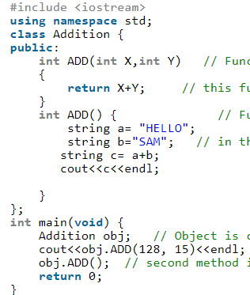
Compile-time polymorphism: Function Overloading
143
HELLOSAM

Slide 22
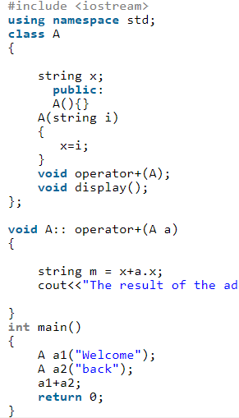
Compile-time polymorphism: Operator Overloading
Operator overloading means defining additional tasks to operators without changing its actual meaning. We do this by using operator function.
Output: Welcomeback.

Slide 23
2. Run-time polymorphism
In a Runtime polymorphism, functions are called at the time the program execution. Hence, it is known as late binding or dynamic binding.
Function overriding is a part of runtime polymorphism. In function overriding, more than one method has the same name with different types of the parameter list.
It is achieved by using virtual functions and pointers. It provides slow execution as it is known at the run time. Thus, It is more flexible as all the things executed at the run time.

Slide 24
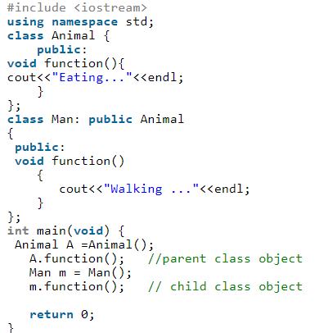
Output
Eating …..
Walking……

Slide 25
Run-time polymorphism: Virtual Function
A virtual function is declared by keyword virtual. The return type of virtual function may be int, float, void.
A virtual function is a member function in the base class. We can redefine it in a derived class. It is part of run time polymorphism. The declaration of the virtual function must be in the base class by using the keyword virtual. A virtual function is not static.
The virtual function helps to tell the compiler to perform dynamic binding or late binding on the function.
If it is necessary to use a single pointer to refer to all the different classes’ objects. This is because we will have to create a pointer to the base class that refers to all the derived objects.
But, when the base class pointer contains the derived class address, the object always executes the base class function. For resolving this problem, we use the virtual function.
When we declare a virtual function, the compiler determines which function to invoke at runtime.
Let’s see the below example for understanding how the program execution happens without virtual function and with virtual function.

Slide 26
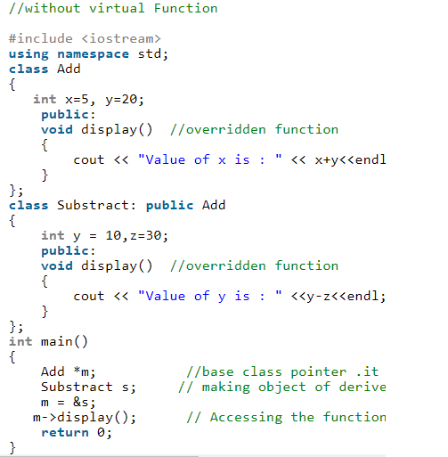
Run-time polymorphism: Virtual Function
Output:
Value of x is: 25

Slide 27
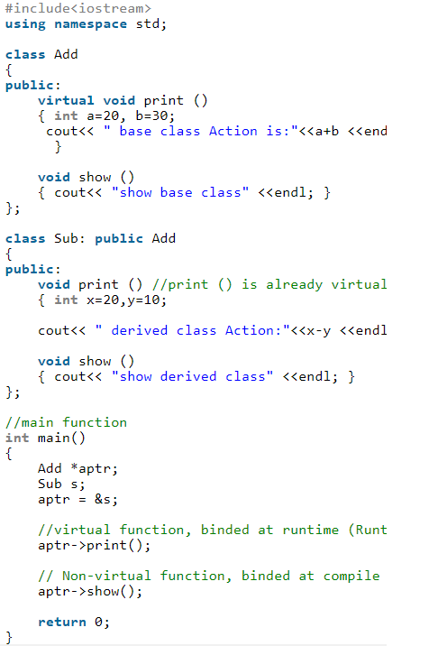
Run-time polymorphism: Virtual Function
Output:
derived class Action:10
show base class

Slide 28
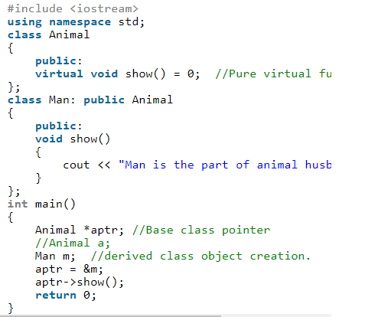
Run-time polymorphism: Pure Virtual Function
When the function has no definition, we call such functions as “Do-nothing function or Pure virtual function”. The declaration of this function happens in the base class with no definition.
Output:Man is the part of animal husbandry

Slide 29
Functions
Functions hold the executable code of a program with a single identifier (function name)
A function has a function header and a function body. The function header comprises of three things { return type, name, and parameter list}
Function declaration, Function definition, function calling.

Slide 30
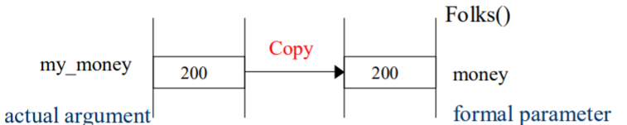
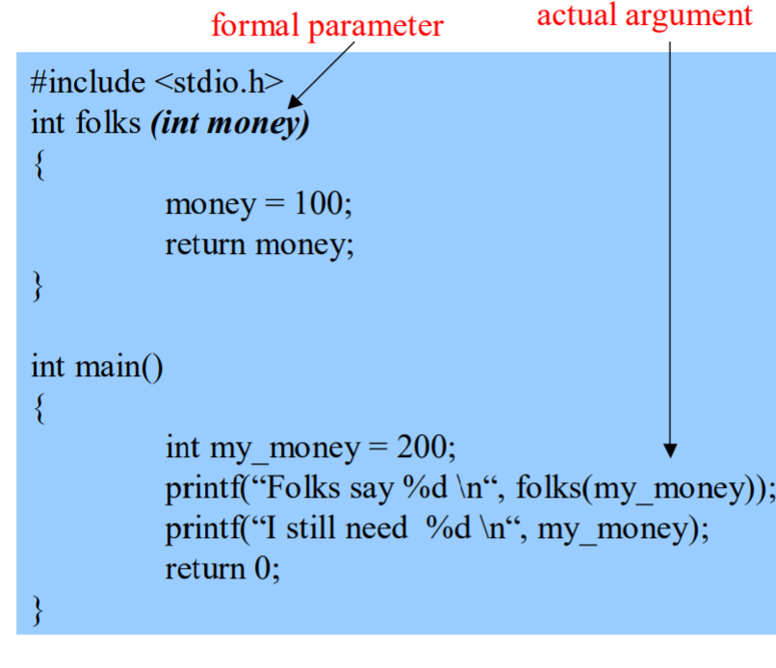
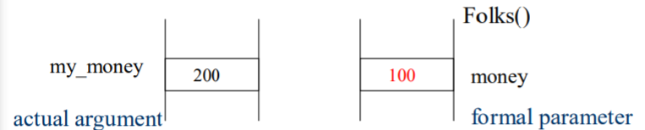
Parameter Passing: Call By Value
The normal technique is call by value, where the actual argument is copied into the formal parameter. Changing the formal parameter does not change the actual argument.

Slide 31
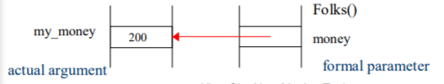
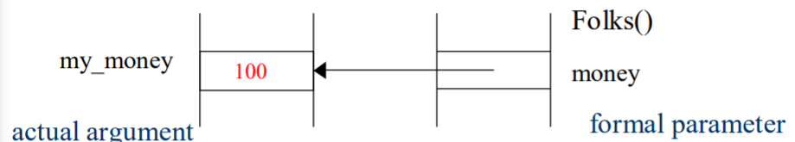
Parameter Passing: Call By Reference
We are passing the address of the argument rather than a copy. Any change to the parameter changes the argument.
my_money is now 100. Folks send you 100
Refer to given Code file passByRef.c

Slide 32
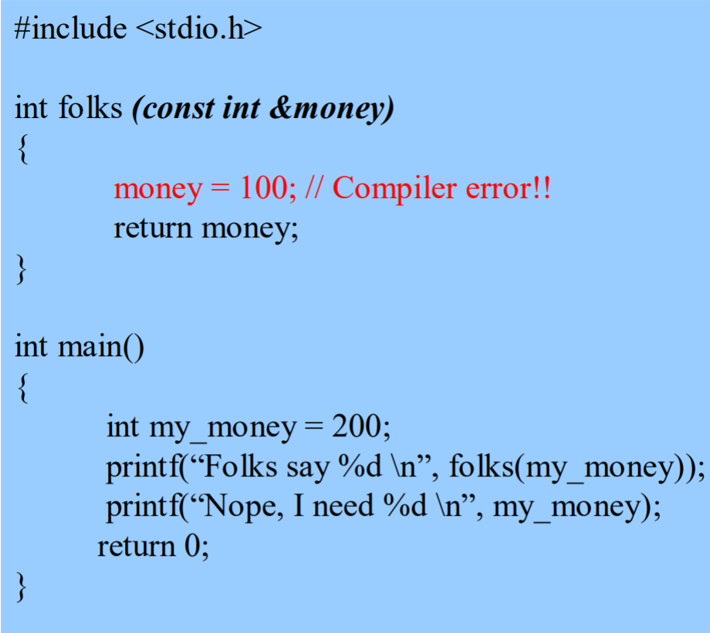
Parameter Passing: Call By Constant Reference
We are passing the address of argument, not a copy. We are not allowed to change the parameter. This particular example generates a compiler error. Folks aren’t allowed to change the amount of money you need!

Slide 33
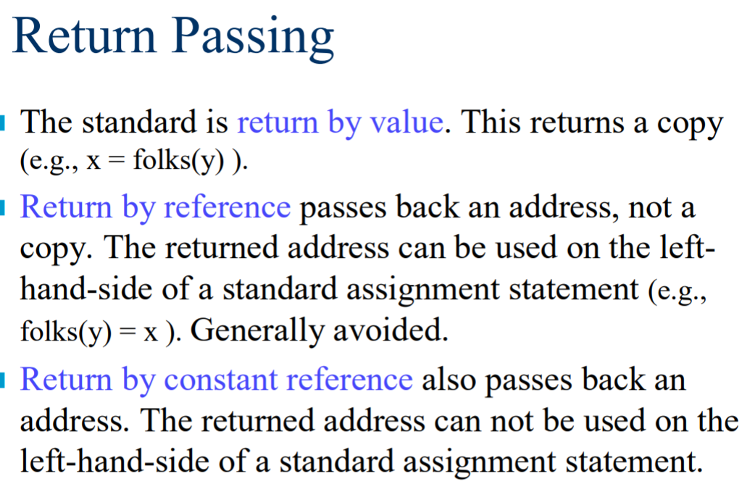

Slide 34
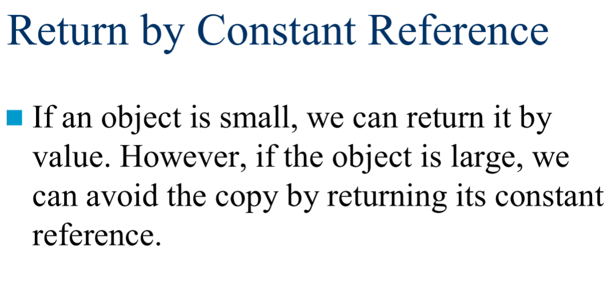
Refer to given Code file returnByRef.c

Slide 35
Pointers
Pointer is a variable whose value is a memory address. Normally, a variable directly contains a specific value. A pointer contains the memory address of a variable that, in turn, contains a specific value. In this sense, a variable name directly references a value, and a pointer indirectly references a value.
Example:
int num;
int *value;
value=&num;

Slide 36
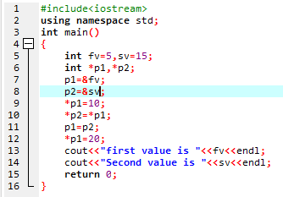
Pointers

Slide 37
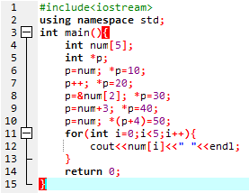
Pointers
Practice these on Dev

Slide 38
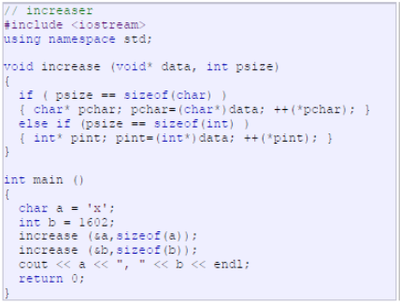
VOID POINTER
Void pointers are pointers that can point to any data type. One limitation of void pointers is that they cannot be directly de-referenced.

Slide 39
NULL POINTER
A null pointer is a regular pointer of any pointer type which has a special value that indicates that it is not pointing to any valid reference or memory address.
Example:
int *p;
p=0;
Do not confuse null pointers with void pointers. A null pointer is a value that any pointer may take to represent that it is pointing to nowhere, while a void pointer is a special type of pointer that can point to some where without a specific type.

